Slide 1
Basement AND Construction

Slide 2

Introduction
The term “basement” has been regarded as synonymous to the term “deep pit”, which applies to excavations over 4.5 m deep. The main purpose of constructing basements are to provide additional space, in some cases, basements may be needed reducing net bearing pressure by the removal of the soil.
Basements are common in large and tall buildings and often used as car parks, stores, underground shopping complexes etc.
In most cases, the main function of the basement in a building is to provide additional space for the owner, and the fact that it reduces the net bearing pressure by the weight of the displaced soil may be quite incidental. In cases where basements are actually needed for their function in reducing net bearing pressure, the additional ﬂoor space in the substructure is an added bonus

Slide 3
Types of Basement
CATEGORIES OF BASEMENT
Basic utility (car parking, plant rooms (excluding electrical equipment, workshops)
Better utility (workshops and plant rooms requiring drier environments )
Habitable (ventilated residential and commercial areas)
Special (archives, requiring controlled environments).

Slide 4
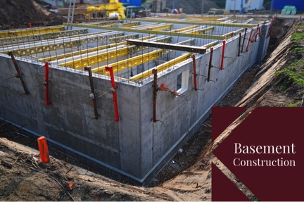
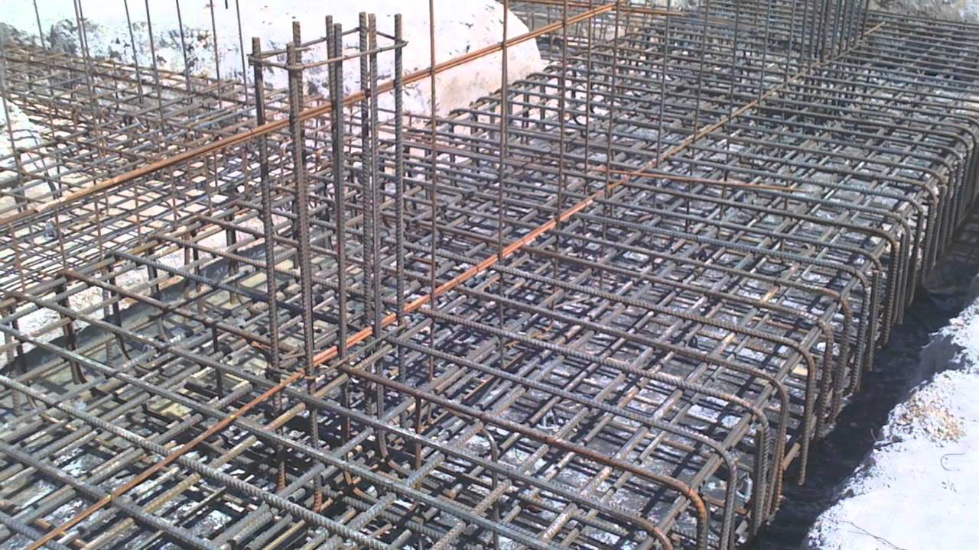
Basement Materials
Poured reinforced Basements
Solid concrete is better able to resist cave-ins caused by lateral pressures of water, earth, and wind.
More fire resistance-because solid concrete is dense and is joint free.
More resistant to water since concrete has fewer and smaller voids than concrete blocks.

Slide 5
Basement Materials
Masonry block Basements:-
The basement walls are made with masonry block units.
There are many joints where the masonry units connect and thus the walls need to be properly and adequately waterproofed (not damp proofed) to avoid water seepage.

Slide 6
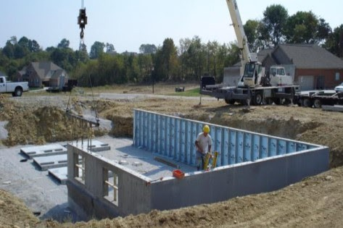
Basement Materials
Precast panel Basements:-
In this method, basement walls are generally molded at a location other than the building site.
The walls can then be transported to the building location and placed on the footer.
The precast basement panel can be created in much the same way as the poured concrete basement.
While the integrity of the walls may be similar to the poured concrete wall, a crane will be needed to place the walls on the footer. The cost for such major equipment can increase the total cost of the basement construction.

Slide 7
Basic Requirements
Care should be taken to build a damp proof basement that doesn't allow ingress of water or moisture.
Design should allow maximum possible light and ventilation.
The local bylaws should be followed and carefully studied before any type of construction.
No objection certiﬁcate from the owners of the neighbouring plots should be secured.
Basements should not increase the risk of ﬂooding from any source and are not being encouraged in areas that are prone to ﬂooding.
Basements should have adequate Fire Safety measures and Means of Escape.
Avoid adversely aﬀecting drainage and run-oﬀ or causing other damage to the water environment.
If groundwater is present, the levels should be monitored for a period of time.

Slide 8
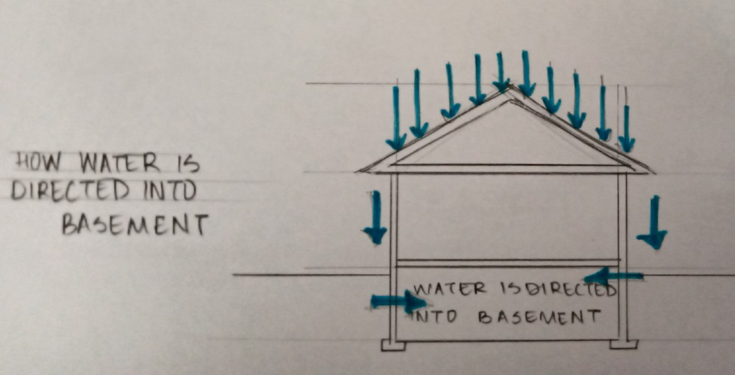
Water Proofing In Basements
Waterprooﬁng a basement is applying a membrane to the basement wall that has the ability to bridge cracks if they should occur in the basement wall. If the site has a high water table or poor soil conditions then a waterprooﬁng system should be used.
However although the soil drains well many people waterproof the basement walls anyway for extra protection against water getting into the basement.

Slide 9
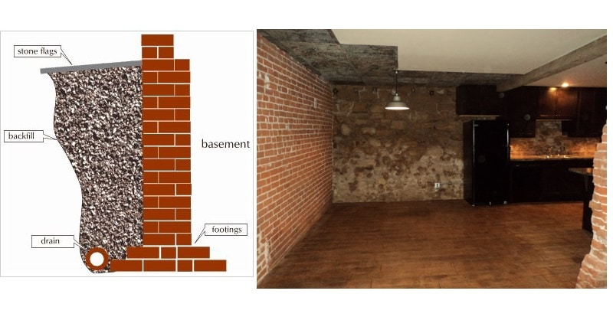
Basement walls
The walls should ideally be cast in RCC.
In certain areas the practice of raising half brick walls and then leaving a gap between them is followed.
This “Desi” practice should be avoided as it reduces work of shattering for the contractors.
The concrete used should be rich, ideally M25.
Vertical reinforcement should be provided on both the faces of RCC walls for basements. In addition, horizontal bars should run inside vertical bars on both faces.
The RCC walls are designed to bear vertical loads from the structure above and the earth pressure on the outer face of walls.
The vertical steel bars should be provided in staggered fashion.

Slide 10
The Major Design Considerations
The major design considerations for deep excavation is divided into five sections :
Planning of surface investigation and laboratory testing.
Evaluation of foundation of adjacent properties and their tolerance.
Selection of type of retaining wall.
Selection of type of support system.
Size of excavation and scale of work Type of soil.
Water table level.
Contractor preference.
Cost factor.

Slide 11
Construction methods of Basements
There are essentially three general methods of constructing a basement:-
Open cut method:- This is the simplest and most straightforward technique of providing an excavation to the required depth. The sides of the excavation are sloped to provide stability, with possible slope protection to maximize the angle of the slope. Upon excavating to the required depth, the basement is constructed from bottom upwards. After the completion of are backﬁlled . the basement, the remaining excavated areas between the basement and the side slope

Slide 12
Advantages and Disadvantages
ADVANTAGES
Because there are no additional support operations and equipment, it is the economical choice.
The open trench provides easy access to the work because equipment and construction materials are minimized. Materials are minimized.
The open cut method is suitable for most ground conditions, except for oozing mud and running sands.
The slope of the bank requires more excavation and backﬁll volume than the other options.
The only bank support is the strength of the soil. If drying, ﬂooding, or change of soil properties weakens the soil, then sloughing and collapse can happen with little or no warning.
The sloped banks require a wider work area.
The bank slopes may force the use of larger equipment because the distance to reach into the trench is increased and a greater volume of soil must be excavated and backﬁlled.
DISADVANTAGES

Slide 13
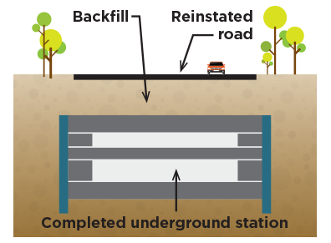
Construction methods of Basements
Cut and cover method:- This technique is usually employed in constrained sites where ground movements to the adjacent surrounding have to be kept to the minimum. Retaining walls are required to support the excavation with the provision of bracing as the excavation proceeds downward until the deepest basement level. The basement is then constructed in the conventional way, bottom upwards in sequence with removal of the temporary struts .
The main disadvantages of a cut and cover tunnel are its disruptive eﬀects in congested urban environments.
Cost of cut and cover construction increases sharply with increased depth.
Tunnel driving costs are usually higher per meter of tunnel that costs than the average shallow cut and cover tunnel

Slide 14
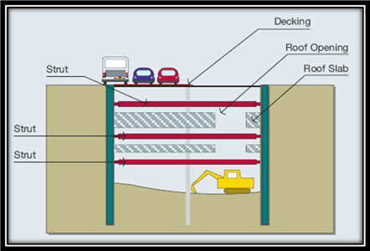
Construction methods of Basements
Top down method:-
Similar to the cut and cover technique, permanent perimeter walls are first constructed. Reverse method of bottom up.
Pre founded columns are then constructed, followed by the construction of the ground floor slab. Steel stanchion/H-sections are inserted, and concrete pumped in to slightly over the lowest basement slab level. The holes are then backfilled with soil. This lower part of the stanchions embedded in concrete will later form the integral part of the foundation for the structure. The upper part of the stanchions not embedded in concrete serves as the column supports for the subsequent basement floors.
Excavation then proceeds downward, and basement slabs are constructed while construction of the superstructure proceeds simultaneously .
Excavation proceeds without the need for strutting to support the excavation as the slabs act as the permanent horizontal supports. When the formation level is reached, pile caps and ground beams are constructed.

Slide 15
Dewatering
Dewatering is the process of removing water from an excavation.
Dewatering may be accomplished by lowering the groundwater table before the excavation work.
This method of dewatering is often used by placing pipelines in areas with high groundwater levels.
There are four basic methods for controlling groundwater:
Open pumping — Water is permitted to flow into an excavation and collected in ditches and sumps before being pumped away.
Pre-Drainage — Lower groundwater table before excavation using pumped wells, wellpoints, ejectors and drains.
Cutoff — Water entry is cut off with steel sheet piling, diaphragm walls, contiguous bored pile and secant pile walls, tremie seals or grout.
Exclusion — Water is excluded with compressed air, a slurry shield, or an earth pressure shield. These methods are frequently used for tunnelling work

Slide 16
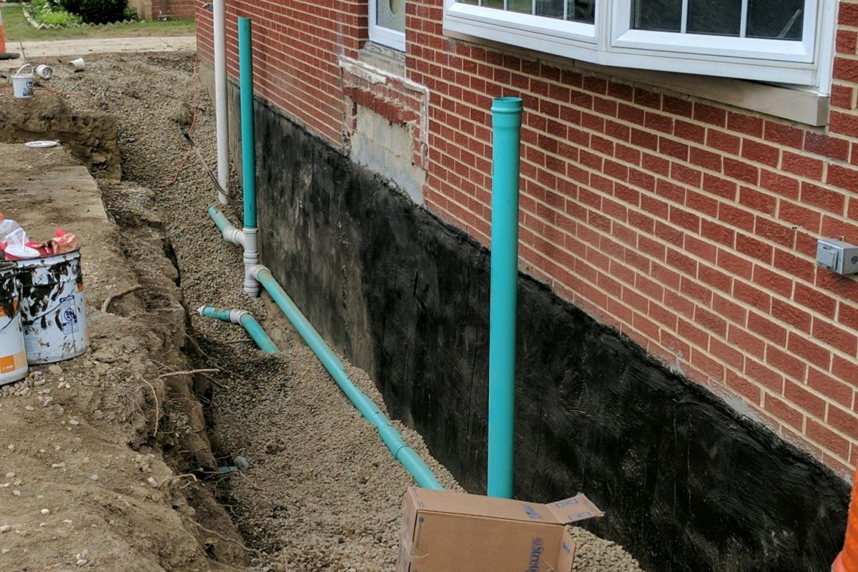
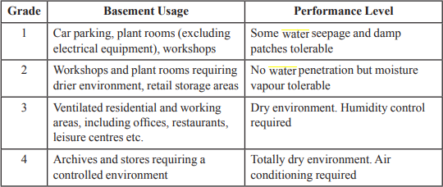
Waterproofing
To achieve the performance level required, one or a combination of the following waterproofing systems may be adopted:
Membrane system
Integral system
Cavity/drainage system

Slide 17
Methods of Waterproofing In Basements
Exterior Basement Waterproofing – This is an extensive method in which contractors' waterproof basements, typically during the construction of the building. Exterior basement waterproofing is designed to prevent water from causing any damages to the structure. In this method, polymers and membranes are used to coat the exterior basement walls. While this method is great for homes under construction it’s generally not recommended for existing homes.
Interior Sealants – Interior sealants are generally used as a temporary material to keep a basement dry. This tool is used to monitor the atmospheric humidity level to ensure the basement is kept dry. Although it’s not a permanent basement waterproofing solution,

Slide 18
Methods of Waterproofing In Basements
sealants can prevent moisture from being absorbed by the structure and can help prevent moisture from traveling to other areas of the home.
3.Interior Water Drainage – This method is one of the most effective water proofing solutions. The installation of a drainage system will help avoid water build up. The drainage system moves the water from the footers of the foundation and out below the basement floor.

Slide 19
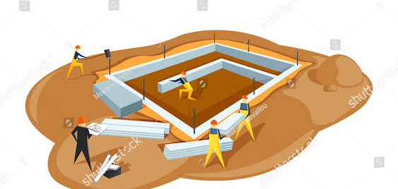
FOUNDATION
BY:-HARMANJOT SINGH & JASBIR SINGH
CRN:-2014029 & 2014033

Slide 20
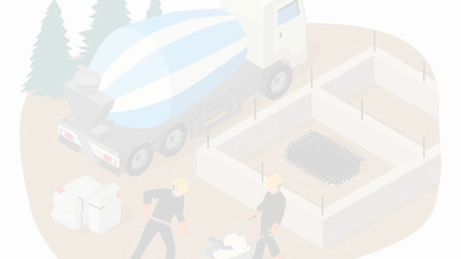
TABLE OF CONTENTS
01
Introduction
05
Shallow foundations
02
Purpose of foundation
06
Deep foundations
03
07
Procedure for constructing a foundation
Factors affecting foundation
04
Types of foundations

Slide 21
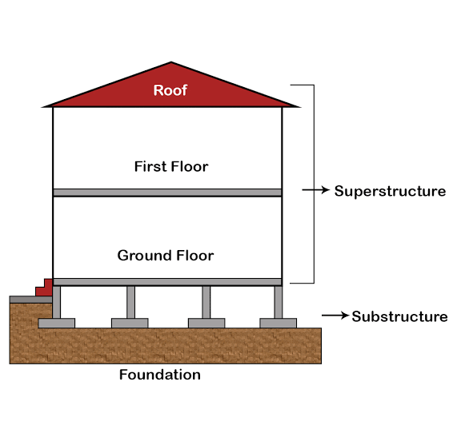
INTRODUCTION
• “The foundation of a building is that part of walls, piers and columns in direct contact with the ground and transmitting loads to the ground.”
• Every building needs a foundation of some kind.
• Because of the variety of soil, rock, and water conditions that are encountered below the surface of the ground and the unique demands that buildings make upon their foundations, foundation design is a highly specialized field combining aspects of geotechnical and civil engineering.

Slide 22
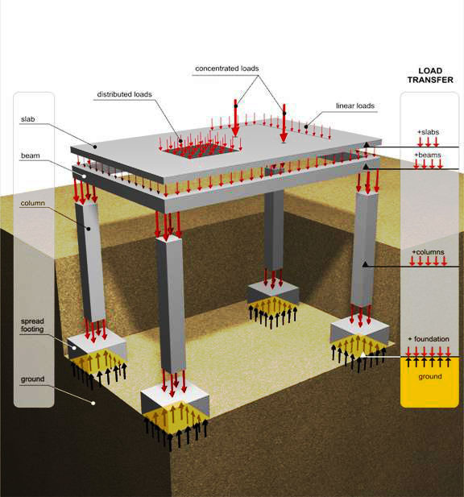
PURPOSE OF FOUNDATION
• To distribute the load of the structure over a large bearing area so as to bring the intensity of load within the safe bearing capacity of soil.
• To load the bearing surface at a uniform rate to avoid differential settlement.
• To prevent the lateral movement of supporting material.
• To attain a level and firm bed for building operations.
• To increase the stability of the structure as a whole.

Slide 23
FACTORS AFFECTING CHOICE OF FOUNDATION
The type of construction.
1.
2.
Drainage conditions.
3.
Feasibility in terms of available skilled labors and cost.
4.
The type and bearing capacity of soil.
The seismic hazard and vulnerability of site to earthquake
5.
6.
The magnitude of load.
FACTORS AFFECTING DESIGN OF FOUNDATION
1.
Soil types and ground water table conditions.
2.
Site condition and environmental factor.
3.
Structural requirements and foundations.
4.
Construction requirements .
5.
Economy etc.

Slide 24
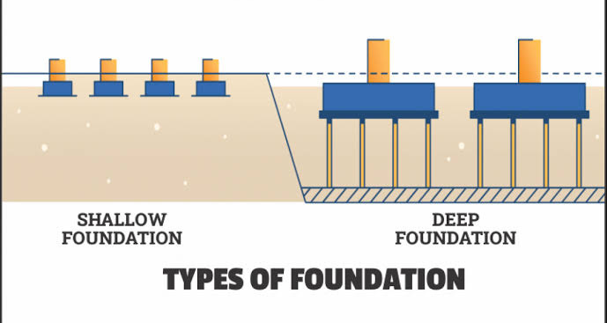
TYPES OF FOUNDATION
There are two basic types of foundations
1. Shallow foundation
2. Deep foundation
SHALLOW FOUNDATION
DEEP FOUNDATION
The foundation provided immediately below the lowest part of the structure near the ground level, transferring load directly to the supporting soil, is known as shallow foundation.
A deep foundation is a type of foundation that transfers loads from superstructures to the earth a greater depths from the surface than a shallow foundation does to a subsurface layer or a range of depths.

Slide 25
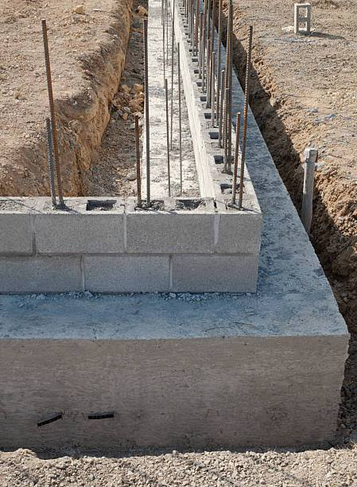
TYPES OF SHALLOW FOUNDATION
From point of veiw of design , shallow foundation may be of following types:
1.SPREAD FOOTINGS
2.COMBINED FOOTINGS
3.STRAP FOOTINGS
4.MAT OR RAFT FOUNDATION

Slide 26
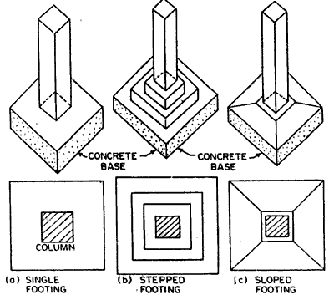
SPREAD FOOTINGS
• A spread footing foundation, which is typical in residential building, has a wider bottom portion than the load-bearing foundation walls it supports. This wider part "spreads" the weight of the structure over more area for greater stability.
• The design and layout of spread footings is controlled by several factors, foremost of which is the weight (load) of the structure it will support.
• These foundations are common in residential construction that includes a basement, and in many commercial structures. But for high rise buildings they are not sufficient.
• A spread footing which changes elevation in several places in a series of vertical "steps" in order to follow the contours of a sloping site or accommodate changes in soil strata, is termed a stepped footing.

Slide 27
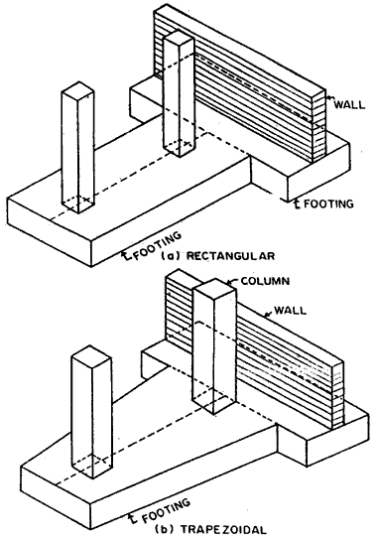
COMBINED FOOTINGS
A spread footing which supports two or more columns is termed as combined footing.The combined footing may be following kinds:
•Rectangular combined footing
•Trapezoidal combined footing
•Combined column-wall footing
Combined footings are invariably constructed of reinforced concrete.
The combined footing for columns will be rectangular if they carry equal loads and will be traezoidal in case of unequal loading.
Sometimes, it may be required to provide a combined footing for columns and a wall. Such foundations are called combined column-wall footings.

Slide 28
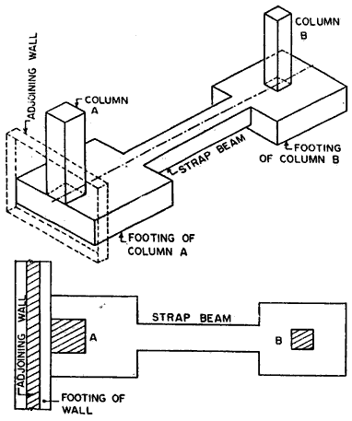
STRAP FOOTING
If the independent footings of two columns are connected by a beam, it is called strap footing. A strap footing may be used when distance between the columns is so great that the combined footing becomes quite narrow, with high bending moments.In that case,each colum is provided with independent footing and a beam is used to connect two footings.The strap,assumed to be infinitely stiff,serves to transfer the column loads on to the soil with equal and uniform soil pressure both footings.

Slide 29
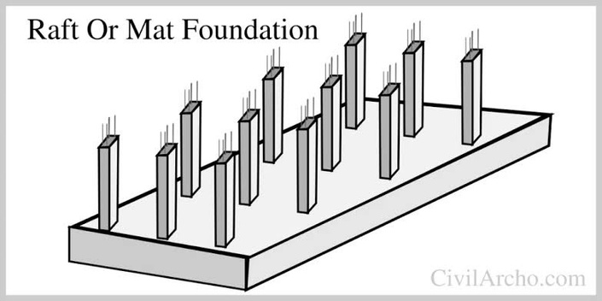
MAT OR RAFT FOUNDATION
A raft or mat foundation is a combined footing that covers the entire area beneath a structureand supports all the columns and walls. When theallowable soil pressure is low or the building loads are heavy, the used of spread foundation covers more than one half area of the foundation, It may prove more economical to use raft or mat foundation
Rafts may be divided into three types,based on design and construction:
•Solid slab system
•Beam slab system
•Cellular slab system
The thickness of slab and size of beam(if any) will be governed by the spacing and loading of the column and degree of rigidity required in the raft.

Slide 30
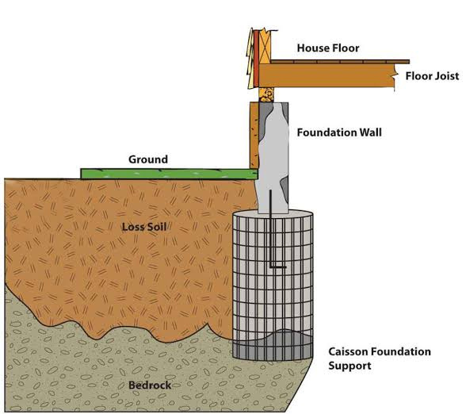
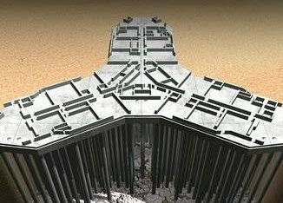
TYPES OF DEEP FOUNDATIONS
01.
PILE FOUNDATION
02.
WELL FOUNDATION OR CAISSONS

Slide 31
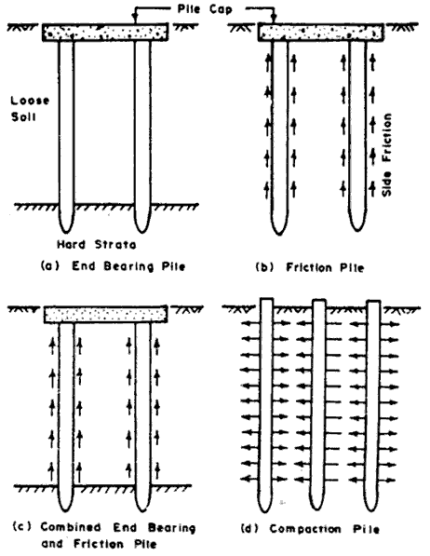
PILE FOUNDATION
Pile foundation is a type of deep foundation in which loads are taken to a low level by means of vertical members which may be of timber,concrete or steel.
Pile foundation is adopted when
•No firm bearing strata exist at any reasonable depth and loading is uneven.
•A firm bearing strata exist at a depth where making a spread footings is uneconomical.
•Pumping of subsoil water is costly or timbering of excavation pits is difficult.
Piles are generally of four types:
•End bearing piles
•Friction piles
•Combined end bearing and friction piles
•Compaction piles

Slide 32
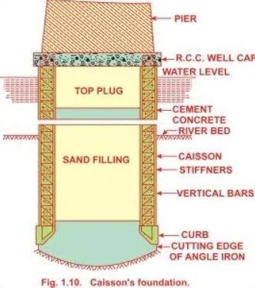
WELL FOUNDATION OR CAISSONS
Well foundation or caissons are box like structures which are sunk from the surface of either lanad or water to the desired depth.
Caissons are used for major foundations, such as:
•Bridge piers and abutments of rivers etc
•Wharves,Quay walls,docks etc
•Large water break and water front structures, subjected to heavy vertical and horizontal loads.
Well foundation or caissons are hollow from inside,which may be filled with sand and are plugged at the bottom.The load is transferred through the perimeter wall known as steining.
Well foundation are not used for buildings.

Slide 33
PROCEDURE FOR CONSTRUCTION OF FOUNDATION
First step is to write a method statement involving scope of work, references, count and type equipments and labour required and requirements .
Ensure you have approved drawings good for construction
Prepare Bar bending schedule for foundations and order reinforcement and ensure materials are on site and correctly stored.
Request survey department to mark foundation centrelines and sizes including working space.
Perform excavation manually or using machines depending on depth, nature of soil and water table. Some time you may need to dewater to keep the water well below the foundation level.
Do not over excavate . Any over excavation should be made top by lean concrete.
Do not expose the foundation level for long time. Ensure lean concrete is poured as soon as foundation level is reached .
Inspect the foundation level for loose material or soft patches.
Lean concrete is normally 75mm in thickness
Following PCC or lean concrete, install reinforcement including column reinforcement or dowels and shutter the foundation. Use concrete covers of required size at the bottom and sides of reinforcement.

Slide 34
Continued...
Once the rebar is in place , with cover you need dust off and get the foundation inspected.
You order correct grade concrete + check slump + temperature before concrete is allowed to be poured.
Compact the concrete in layers using vibrators without leading to segregation.
Cast the cubes to test at 7 and 28 days.
Cure the cast concrete for minimum of 10 days if it is wet curing.
Deshuttering of vertical faces is normally 24 hour to 48 hours.
Once deshuttered and cured foundation is provided with coating or membrane protection.
Finally, foundations are backfilled by selected approved fill material in layers of 200mm or less to 95% degree.

Slide 35


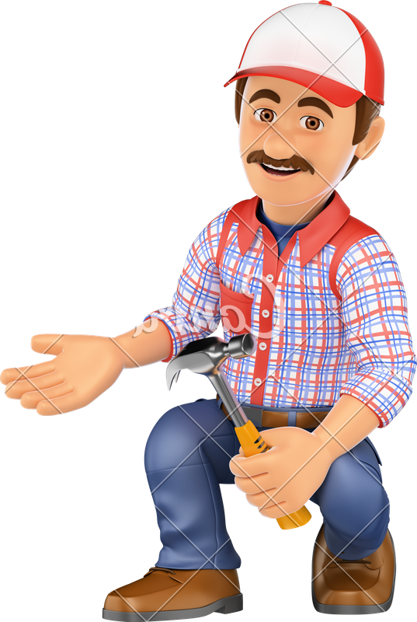
Temporary Shed
Temporary Shed
01/30

Slide 36

TABLE OF CONTENTS
Temporary Shed
What is shed?
Types of shed
Pros and cons of temporary Vs permanent shed
Temporary Vs permanent building construction
Uses of temporary shed
Some guidelines for temporary shed are as follow: (as per code:- IS8758:2013)
Types Of temporary shed (On the basis of material)
02/30

Slide 37
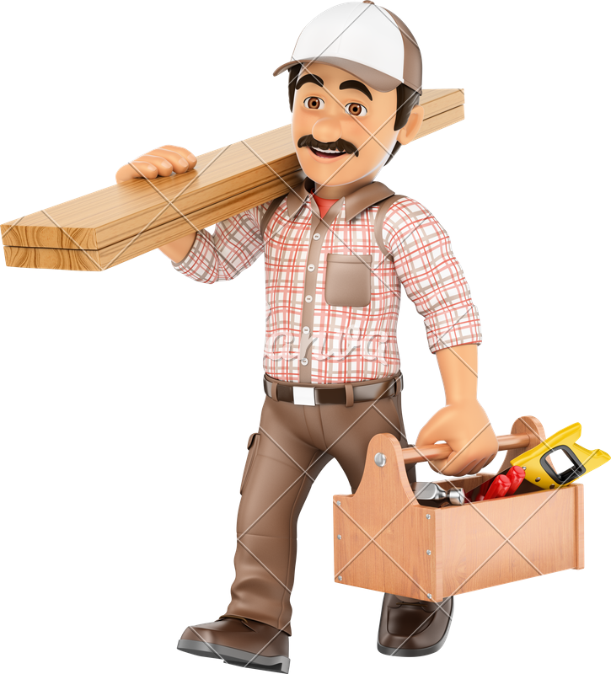
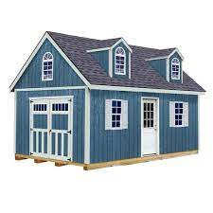
Temporary Shed
What is shed?
Shed is thought to have originated as a variant of ‘shade’ since early sheds were often open at the front and sides and so provided shade and shelter rather than being completely enclosed. A typical shed today is a small building used for storage.
In short Shed is a slight structure built for shelter or storage.
03/30

Slide 38
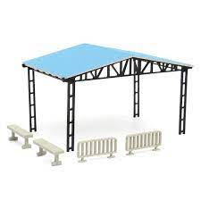
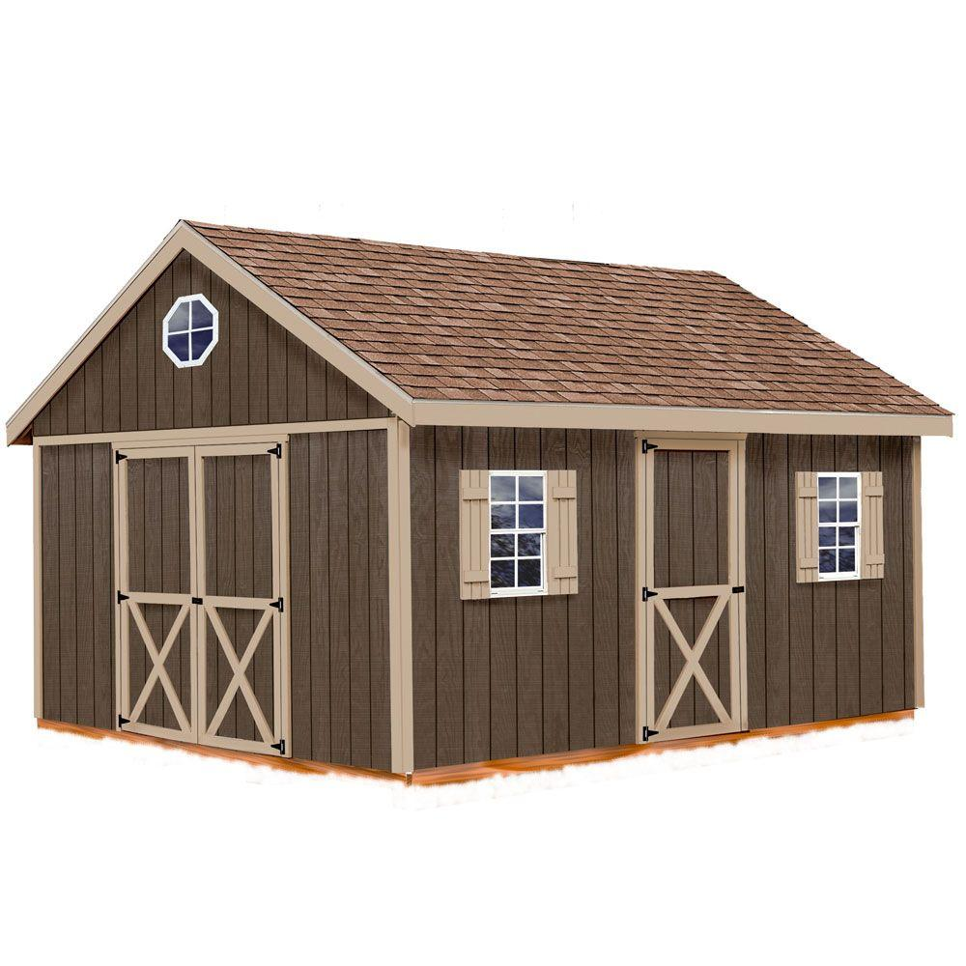
Temporary Shed
Types of shed
Temporary Shed
If the structure is not attached to any permanent foundation and are easy to set up, take down, and move, it is known as temporary Shed
Permanent Shed
If the structure is permanently attached to the permanent foundation or stays in the same location for longer than six months, it is known as permanent Shed
04/30

Slide 39
Temporary Shed
PERMANENT SHED PROS
Durable
Permanent structures are designed to be long-lasting and remain in place for an extended period. They are typically made of more durable materials, such as wood, metal, or concrete, and are often built on a foundation or concrete slab to provide added stability.
Made Using Strong Materials
If you compare permanent structure vs. temporary structure, the manufacturers make the permanent structure using stronger materials.
05/30

Slide 40
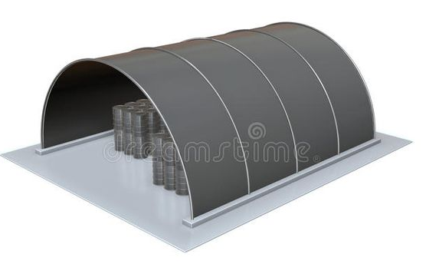
Temporary Shed
TEMPORARY SHED PROS
Shorter Construction Time
On average, a temporary shed takes 30-40 days to build. Additionally, temporary sheds are generally much easier to assemble and disassemble than permanent sheds.
Flexible
Temporary structures are typically made of lighter materials, such as plastic or fabric, and are easy to set up, take down, and move as needed.
06/30

Slide 41
Temporary Shed
PERMANENT SHED CONS
Expensive
A major problem in having a shed with a permanent structure is that it is expensive. Because the makers have used durable materials in their construction, they cost more. Thus, the price of such sheds is higher.
Takes Longer Construction Time
A permanent structure requires 2 to 6 months for construction. Such a duration is quite longer than that for temporary structures. However, the fact that they serve for a longer period, you may compromise on the construction time depending on your demand.
07/30

Slide 42
Temporary Shed
TEMPORARY SHED CONS
Not Constructed Using Strong Materials Like Steel
The major con of having a shed with a temporary structure is that it does not comprise stronger materials like concrete and steel. The reason for that is the makers must make it lightweight and mobile.
Comparatively Less Durable
Since temporary structures comprise stronger materials, they are less durable. However, they do last for many years if you keep a check on their maintenance.
08/30

Slide 43
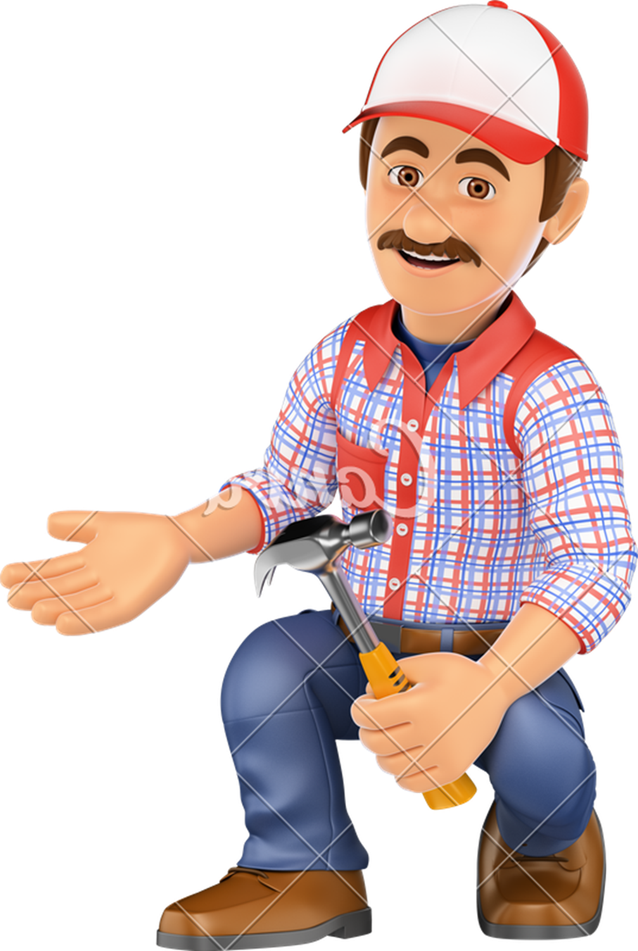
Temporary Shed
TEMPORARY BUILDING CONSTRUCTION Vs PERMANENT BUILDING CONSTRUCTION
TEMPORARY BUILDING CONSTRUCTION |  | PERMANENT BUILDING CONSTRUCTION
Types of shed
Temporary building systems are resilient, built strong enough to be torn down and reinstalled or relocated. Their tough exteriors and cleverly engineered components make them an enormously versatile asset for any business that needs this feature. |  | While permanent construction has similar design elements, buildings like these are usually constructed on a foundation, making them immovable. Of course, being immovable also means they are eligible for advanced customization and may be preferable for long time settlement.
09/30

Slide 44
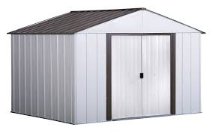
Temporary Shed
USES OF TEMPORARY SHED
As temporary shed are easy to move therefor it is often used to set up surgical/medical camps or refugee camps in case of emergencies.
During construction, if you have expensive tools or other items that could be damaged by exposure to extreme weather conditions over time. a temporary storage shed can be used to safeguard construction materials and valuable machinery from damage caused by moisture, dust, rain, snow, and other ecological factors.
10/30

Slide 45
Temporary Shed
Some guidelines for temporary shed are as follow: (as per code:- IS8758:2013)
The materials, design, construction, fabrication of structures or devices within the scope of this standard shall meet the requirements for resistance to fire of a minimum of 10 minutes or total evacuation time whichever is more.
The choice of materials for such constructions shall preferably be of non-combustible or fire resistance type. The materials used for the decor shall be such that it shall not generate toxic smoke/fumes. Wherever materials of combustible nature are used these shall be treated with a fire-retardant material.
11/30

Slide 46
Temporary Shed
Some guidelines for temporary shed are as follow: (as per code:- IS8758:2013)
The height of the ceiling of the structure or pandal from the ground shall not, in any case, be less than 3m.
In no case, the height of corridor/passageway shall be less than 3 m.
Temporary structures shall be adequately guyed/ braced and made secure to withstand a wind pressure of 0.98 kN/m.
All electrical wirings in the structure or pandal shall be in PVC sheathed conductors or vulcanized rubber cables of tough rubber and all joints shall be made with porcelain insulated connectors. Twisted and tapped joints shall not be permitted.
12/30

Slide 47
Temporary Shed
Some guidelines for temporary shed are as follow: (as per code:- IS8758:2013)
No part of electrical circuit, bulbs, tube lights, etc., in the structure of pandal shall be within 15 cm of any decorative or other combustible material.
All temporary structures shall be periodically inspected, and any deterioration and defect observed shall be brought to the notice of the authority for remedy.
No fire works or open flame of any kind shall be permitted in any temporary structure or in the immediate vicinity.
13/30

Slide 48
Temporary Shed
Types Of temporary shed (On the basis of material)
Fabric Sheds
Fabric shed are constructed using a rigid frame, which can consist of timber, steel, rigid plastic, or aluminum, and a sturdy fabric outer membrane. Once the frame is erected, the fabric cover is stretched over the frame. The fabric cover is tensioned to provide the stable structural support of the building. The fabric is tensioned using multiple methods, varying by manufacturer, to create a tight-fitting cover membrane.
14/30

Slide 49

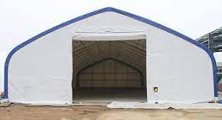
Temporary Sheds
15/30

Slide 50
Temporary Shed
Types Of temporary shed (On the basis of material)
Metal Shed
Metal sheds are made from thin sheet metal sheathing attached to a metal frame. Metal sheds are a good choice when long-term strength and resistance to fire, rot, or termites are desired. However, metal sheds may rust over time, particularly if they are constructed from steel that is not galvanized.
16/30

Slide 51
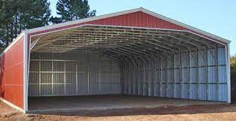
Temporary Sheds
17/30

Slide 52
Temporary Shed
Types Of temporary shed (On the basis of material)
Plastic shed
Plastic shed kits utilizing heavy molded plastics such as PVC and polyethylene may be less expensive than sheet-metal sheds. PVC resins and high-impact, UV light-resistant polyethylene make plastic outdoor sheds stronger, lighter, more durable, and more resistant to denting and chipping than wood, and tend to be more stable.. Higher-quality sheds use UV-resistant plastic and powder-coated metal frames.
18/30

Slide 53
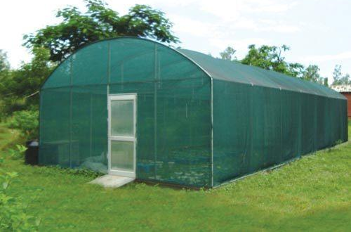
Temporary Sheds
19/30

Slide 54
Temporary Shed
Types Of temporary shed (On the basis of material)
Woodshed
Wooden sheds have a natural look that can blend in well with garden environments. Despite the strength of wood, over time, untreated and neglected wood can rot, split, warp or become susceptible to mold and mildew, so woodsheds should be treated for protection with stain and varnish. Woodsheds need regular maintenance. This includes keeping plant matter and debris from piling up beside the walls and on the roof, and occasional rot-proofing with preservatives.
20/30

Slide 55
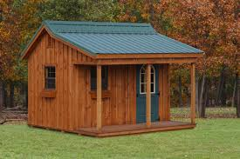
Temporary Sheds
21/30

Slide 56
Temporary Shed
Types Of temporary shed (On the basis of material)
Vinyl-sided sheds
Vinyl-sided sheds are typically built with standard wood framing construction and oriented strand board (OSB) on the walls covered with standard vinyl siding. The vinyl siding protects the OSB wood and the frame from moisture from rain and snow. Vinyl-sided sheds never need to be painted and are maintenance-free. They are stronger than plastic or metal sheds and are usually built to conform with the local building codes.
22/30

Slide 57
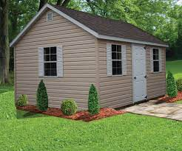
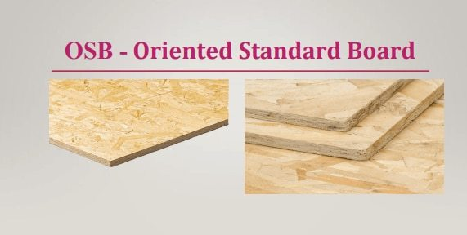
Temporary Sheds
23/30

Slide 58
Temporary Shed
Types Of temporary shed (On the basis of material)
Thermoplastic rubber (TPR)
Since 2013 garden sheds have been available in the UK made from TPR - a sustainable alternative to concrete. They are typically coated in a marine gelcoat and are far stronger and more durable than traditional sheds. A shed made from TPR became the first Secured by Design-approved shed in 2014.
24/30

Slide 59
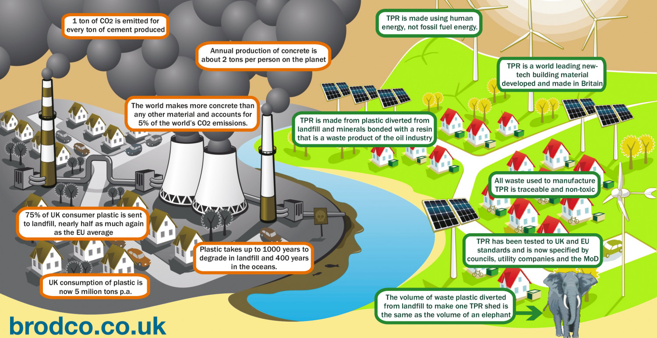
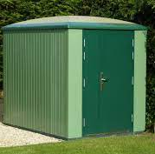
Temporary Sheds
25/30

Slide 60
Temporary Shed
Types Of temporary shed (On the basis of material)
PUF Panel Sheds
PUF or polyurethane foam panels are one of the most widely used sandwich panels in prefabricated construction technology. It consists of two sheets made of pre-painted galvanized iron or an equivalent structural sheet, which forms an insulated layer around the core made of by polyurethane form. PUF panel sheds are a good choice when long-term strength and resistance to fire, weather, rot, or termites are desired.
26/30

Slide 61
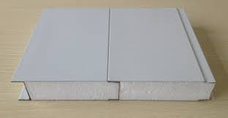
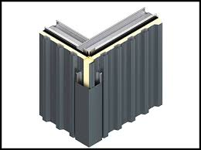
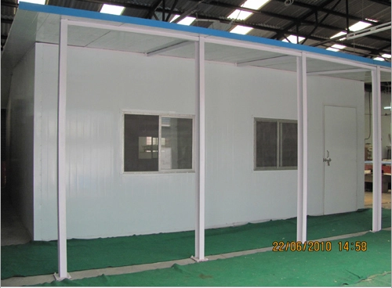
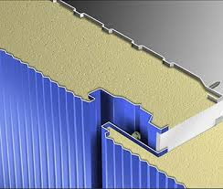
Temporary Sheds
27/30

Slide 62

Temporary Sheds
Question's
1Q What are the factors affecting foundation?
2Q What is Deep foundations?
3Q As per code IS8758:2013 temporary structures shall be adequately guyed/ braced and made secure to withstand a wind pressure of _____kN/m.
a) 0.98 b) 0.94 c) 0.96 d) 0.95
4Q What are the consciences if wooden shed remain untreated and neglected overtime?
28/30

Slide 63
Temporary Sheds
Answer’s
1Ans. The type of construction, Drainage conditions, Feasibility in terms of available skilled labors and cost, type and bearing capacity of soil, seismic hazard and vulnerability of site to earthquake, magnitude of load.
2Ans. A deep foundation is a type of foundation that transfers loads from superstructures to the earth a greater depths from the surface than a shallow foundation does to a subsurface layer or a range of depths.
3Ans. 0.98
4Ans. Despite the strength of wood, over time, If wooden shed remain untreated and neglected wood can rot, split, warp or become susceptible to mold and mildew.
29/30

Slide 64
Temporary Sheds
Thank You
30/30

